Slide 1
Biotech Company Market Pivot ANP Model
Jeremy Friedman
October 19th 2022

Slide 2
Background
Company A is behind their competition on their scientific research. Company B will likely be the first-to-market, ensuring their product out paces Company A and leaves A in the dust. Company A needs to decide whether to stick with their current market solution or pivot the company into a new area of research.
Alternatives:
Stay – remain in current scientific market.
Pivot – enter a new target market.

Slide 3
Alternatives
Stay
Allows for continuity within scientific expertise, no added costs for remodeling or pivoting, no lag time in research, might lose chance of being first-to-market thus losing a significant market share.
Pivot
Enter a new target market, requiring costs of renovation and equipment change, lag time in restarting research, loss and change of scientific expertise, but with a chance of being first-to-market in a new field and beating out all competition.

Slide 4
Criteria
Finances
Competition – quantity and quality of competition in the current field.
First-to-Market – the chance of being the first product solution on the market.
Current Financial trajectory – current to future financial situation.
Renovation Costs – any equipment and facility changes in pivot.
Operations
Scientific Expertise – cost of keeping or turning over current field experts.
Lag time in Pivot – time required to get restarted in a pivot situation.
Company Optics – what outside speculators observe from a stay or pivot situation.
Stakeholders: CEO, CFO, COO.

Slide 5
Relationships
Finances
Competition
First-to-Market
Current Financial Trajectory
Renovation Costs
Operations
Scientific Expertise
Lag time in Pivot
Company Optics

Slide 6
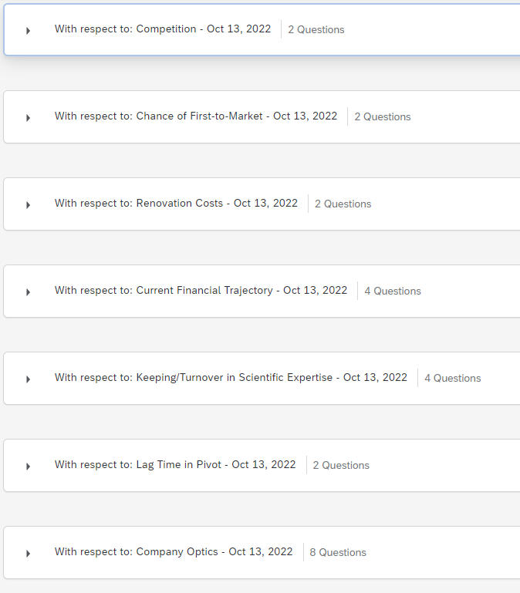
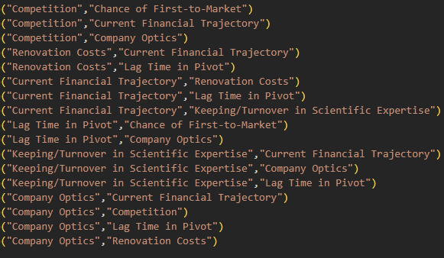
Examples
Above: code showing relationships between criteria nodes.
Right: Categories of questions built from criteria relationships.

Slide 7
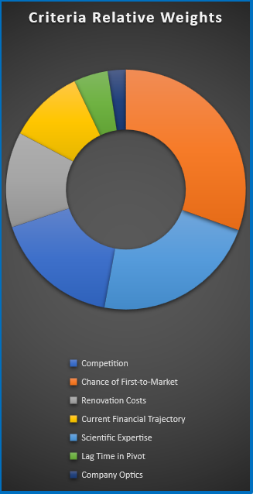
Results
Above: showing values of each criteria for each alternative.
Right: showing relative weights (importance) of each criteria for the stakeholder’s value.

Slide 8
Results
By using a sum product of criteria values by criteria weights the priority values were calculated and normalized for each alternative.
Pivot outweighs Stay by 24%

Slide 9
Conclusion
By calculation of evaluated and weighted criteria, Pivot alternative outweighs Stay by 24%.
Top three criteria by weights: First-to-Market, Scientific Expertise, Competition.
First-to-Market criteria excluded from node relationships, needs to be included for more accurate model.

Slide 10
Recommendations
Including First-to-Market in the node relationships, to improve the model.
Increasing number of criteria relationships in modeling.
More stakeholders can be surveyed, such as: employees, board members, advisors.
Company A, based on the given ratings and priorities, should pivot into a new market. The new research area should focus on being able to be first-to-market, having overlap with their current scientific expertise, and in a field of low competition. Based on their top three weighted criteria.

